Slide 1

Lab Exercise
House Price Prediction

Slide 2
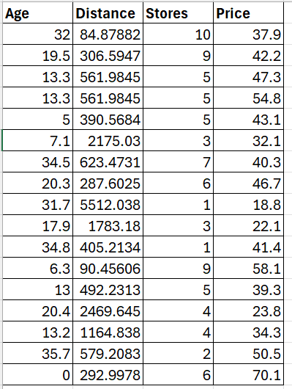

House Price Data

Slide 3
Tasks
Read the CSV file
first three variables into x and the output variable into y
Create Polynomial Features (degree 10) then apply StandardScaler
Fit the Ridge and Lasso Regression Model
Computer R2 score and MSE
Perform train-test split

